Slide 1
(EM)CCD Simulator
Nicholas Jones (njones31@vt.edu)
Mission Systems Division, National Security Institute

Slide 2
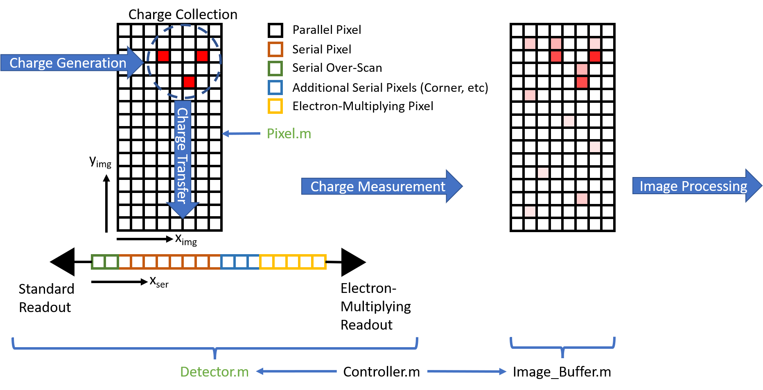
Model Overview
(EM)CCD model has been implemented in MATLAB to simulate detector operations at high fidelity
Charge Generation
Charge Collection
Charge Transfer
Charge Measurement
Noise Processes
The detector is modelled at the individual pixel level
Modelling of pixel level defects
Explicit definition and execution of read-out sequences
Currently implemented in temporary Rough_Driver.m

Slide 3
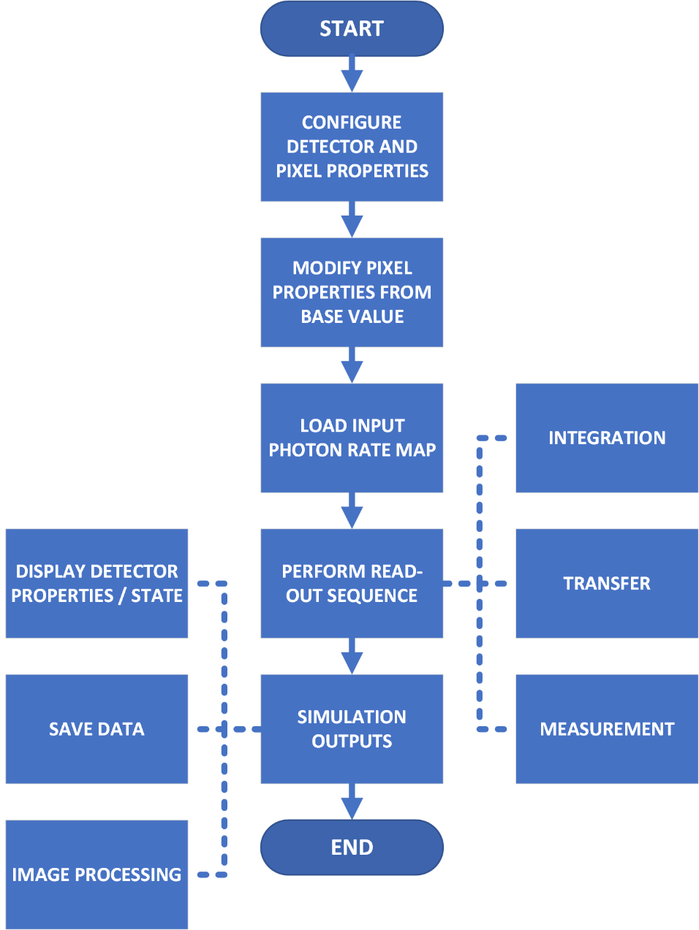
Code Overview
Process | Model | Notes | Reference
Incoming Photons | Poisson Distribution | Shot Noise
Photon Interaction | Binomial Distribution | Interacting Quantum Efficiency
Quantum Yield | Binomial Distribution | Fano Noise | [1]
Dark Current | Poisson Distribution
CIC | Poisson Distribution
Charge Transfer Efficiency | Binomial Distribution
Electron Multiplication | Binomial Distribution | Captures ENF | [2]
Read Noise | Normal Distribution
Priorities with this initial version is to capture major processes and dominant noise sources within the EMCCD detector
Supply a base to further grow fidelity and feature-set

Slide 4
Pixel
Lowest level representation is the Pixel class
Used to store information regarding pixel state and properties
By setting different properties, different pixel functions can be modelled (image section, transfer section, serial pixel, etc)
Property | Description
Interacting Quantum Efficiency | Determines the number of incident photons that generate an e-h pair (0 – 1)
Quantum Yield | Determines the probability of an interacting photon producing a second e-h pair (≥ 1)
Full Well Capacity | Sets the signal level at which a pixel will start to bloom (e⁻)
Charge Transfer Efficiency | Determines the amount of charge transferred (0 – 1)
Dark Current Rate | Dark current generation rate (e⁻ s⁻¹)
Clock – Induced – Charge Rate | Mean CIC rate, defined per transfer (e⁻ transfer⁻¹)
Multiplication Probability | Probability of electron multiplication per electron within the pixel (0 - 1)
Length / Width | Pixel dimensions (µm)

Slide 5
Detector
Contains pixel arrays representing the parallel and serial sections
Coordinates transfer of charge between pixels
Allows for setting pixel level properties within the array to simulate non-uniformities and defects
Properties can be set independently between the parallel and serial sections
Supports using the standard or EM readout of the detector
Property | Description
Parallel Section Length / Width | Size of the parallel section (Pixels)
Serial Register Overscan | Number of overscan elements in the serial section before the standard readout (Pixels)
Serial Additional Elements | Number of elements in the serial register between the image section and EM elements (Pixels)
Serial Multiplying Elements | Number of electron – multiplying elements in the serial register (Pixels)
Operating Mode | Controls operating through the standard or EM read-out
Read Noise | RMS read-out noise for the read-out amplifier (e⁻)
Read Bias | Bias applied to the read-out (e⁻)
Vertical Frequency | The frequency at which parallel transfers occur (Hz)
Horizontal Frequency | The frequency at which serial transfers occur (Hz)

Slide 6
Charge Generation
Incoming Photons
Implemented as map of incoming mean photon incidence rate over the parallel section of the array
Specified in mean photons per seconds
Charge is generated for all steps of the process for which a finite time interval is defined
Includes integration times and during vertical and parallel transfers
The number of photons incident on a pixel over a time interval is determined by multiplying the mean photon incidence rate by the time interval, then using this mean number of incident photons to feed a Poisson random number generator to simulate shot noise
The number of interacting photons is then determined by the interacting quantum efficiency
A binomial distribution is used, where each interacting photon is a “trial”, and the probability of successfully interacting with the pixel is set by the interacting quantum efficiency.
Fano noise is simulated through allowing the interacting photons to generate multiple electron-hole pairs within the pixel
Implemented model in [1]. Probability of an additional e-h pair being generated is given by the quantum yield – 1
Modelled as a Bernoulli process where the number of additional e-h pairs generated is determined by a binomial distribution
Each interacting photon is a “trial,” and the probability of success of that trial is given by the probability of generating an additional e-h pair
Dark Current
The mean dark current generation rate, along with the time interval, are used to inform a Poisson distribution to generate dark current over each interval

Slide 7
Charge Collection
Model currently assumes high performance for charge collection parameters
Charge generated within a pixel remains within that pixel
Exceedance of full well capacity can be checked through query of bloom status of each pixel
Charge blooming is not modelled
Can check which pixels have exceeded the provided full well capacity, but no charge spreading functionality is implemented to model the process of blooming
Charge diffusion is not modelled
On-detector fixed pattern noise is not explicitly modelled
May be possible to approximate through setting patterns in the interacting quantum efficiency

Slide 8

Charge Transfer
Coordinated by the Detector class
Charge can be transferred in the forward and reverse directions in the parallel and serial sections
Before each transfer, charge is generated in the parallel and serial section to best reflect the total signal levels
For a large number of consecutive serial transfers (as is common), charge generation in the parallel section can be deferred to occur all at once for computational efficiency
Recommended when not concerned with transient behavior of the detector
Based on timing given by vertical and horizontal frequencies
Amount of charge transferred is based on the ‘from’ pixel CTE.
Modelled using a binomial distribution, where each electron is a “trial,” and the probability of being successfully transferred is given by the CTE
CIC is added to the out-going charge cloud during each transfer
Charge multiplication (for those pixels with multiplication set to a non-zero value) is applied upon transferring that charge into the pixel

Slide 9
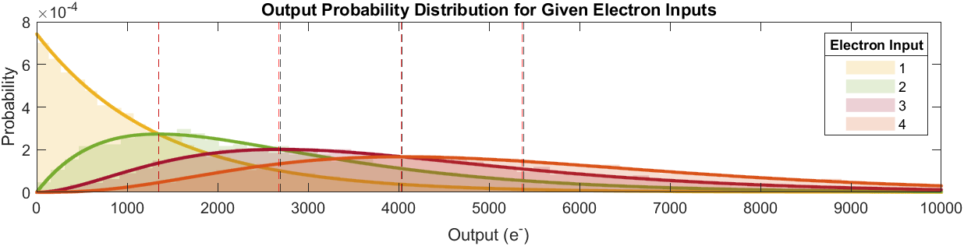
Charge Multiplication
Based on description of electron multiplication process and statistics in Basden et al., 2003 [2].
When transferring charge into a pixel with a multiplication probability greater than 0, a binomial distribution is used to determine which electrons are multiplied using the multiplication probability as the probability of success
The multiplied electrons are then added to the charge cloud
Variability of multiplication captures the Excess Noise Factor (ENF)
Plot below shows simulation of electrons multiplied through multiplication elements
Shaded histograms represent simulation output
Solid line plots shows analytical expression provided for output probability in [2]
Red dashed lines show the simulation mean output
Black dashed lines show the calculated mean output
Property | Value
Multiplication Probability | 0.012
Number of Multiplication Elements | 604
Calculated Mean Gain | 1345.95
Number of Trials per Input | 10000
Simulation adheres to ≲1% of predictions in [2]

Slide 10

Charge Measurement
Charge measurement is accomplished at the EM or standard readout register, whichever is selected for operation
Read noise is applied using a normal distribution (zero mean, variance as specified in the detector configuration)
A bias level can also be applied to the read-out
Measurement is completed as part of a serial transfer where charge is moved out of the final pixel

Slide 11
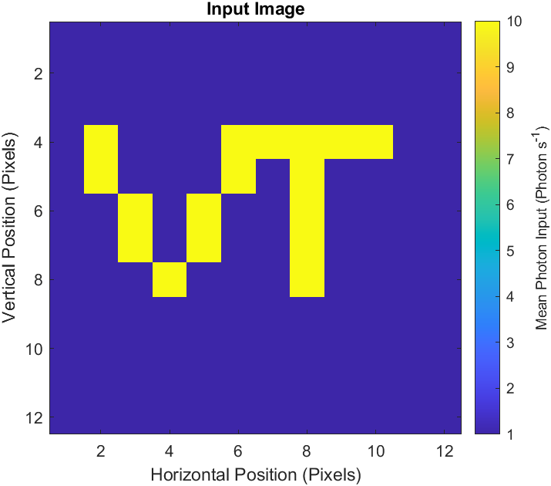
Demonstration
Simulated 1000 read-outs with 0.01 s integration time
Small, 12 x 12 pixel detector
Test image shown below
Detector Property | Value
Parallel Section Width | 12 Pixels
Parallel Section Length | 12 Pixels
Serial Overscan | 2 Pixels
Additional Serial Pixels | 2 Pixels
Multiplication Elements | 50 Pixels
Read Out Noise (RMS) | 3 e-
Read Bias | 500 e-
Vertical Frequency | 0.9e6 Hz
Horizontal Frequency | 1e6 Hz
Pixel Property | Value
CTE | 0.999999
Dark Current Rate | 0.0015 e- s⁻¹
Pixel Length | 13 μm
Pixel Width | 13 μm
Parallel Pixel Property | Value
Interacting Quantum Efficiency | 0.9
Quantum Yield | 1.2
Full Well Capacity | 80k e-
CIC Rate | 1e-4 e- tr⁻¹
Serial Pixel Property | Value
Full Well Capacity | 360k e-
CIC Rate | 1e-3 e- tr⁻¹
EM Multiplication Probability | 0.1

Slide 12
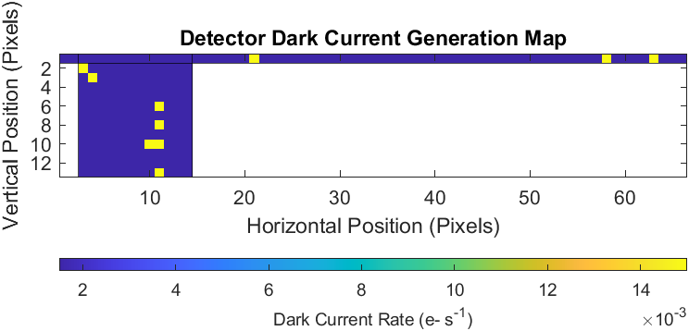
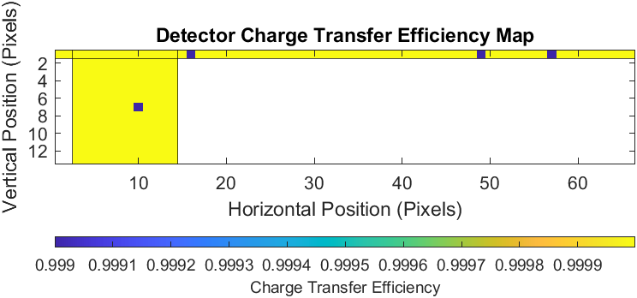
Demonstration
Random hot pixels and degraded charge transfer performance is added to the array
5% of parallel section pixels have 10x the dark current generation rate
1% of parallel section pixels have CTE = 0.999
5% of serial section pixels have 10x the dark current generation rate
5% of serial section pixels have CTE = 0.999

Slide 13
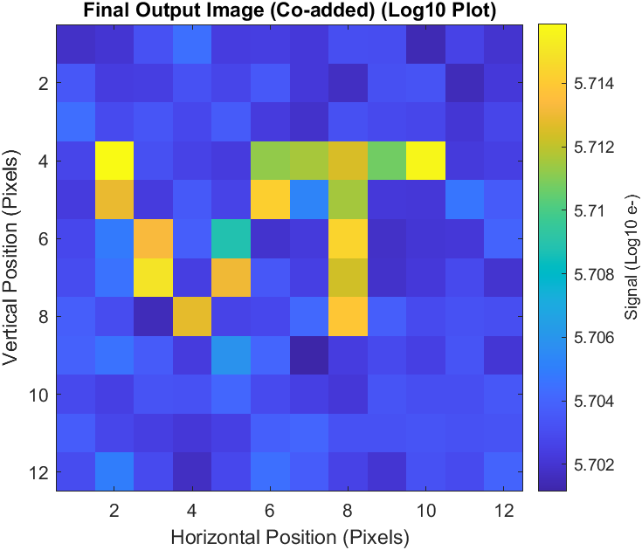
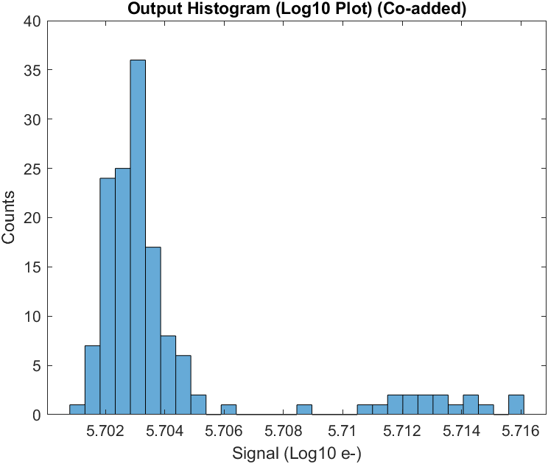
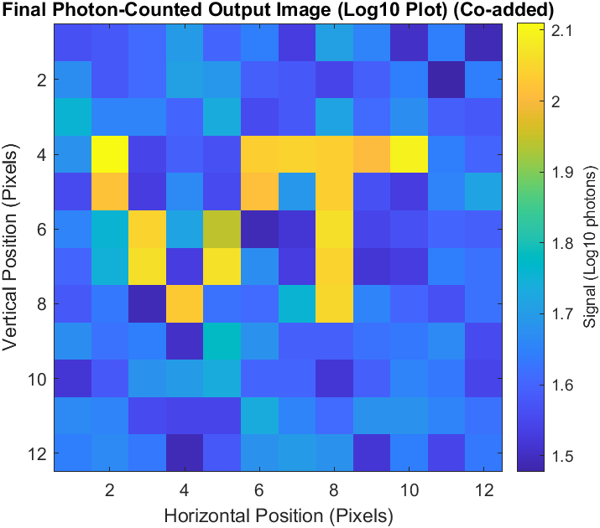
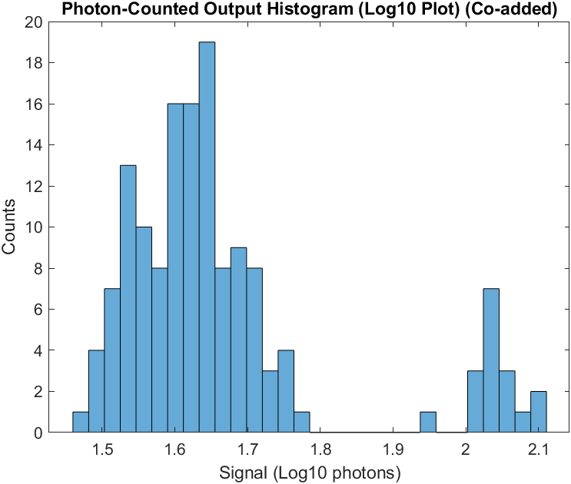
Demonstration
Results for EM register output =>
Photon Counting process not applied
Coadding 1000 read-outs to arrive at final image
With photon-counting applied =>
Using 5-sigma threshold above the read-noise

Slide 14
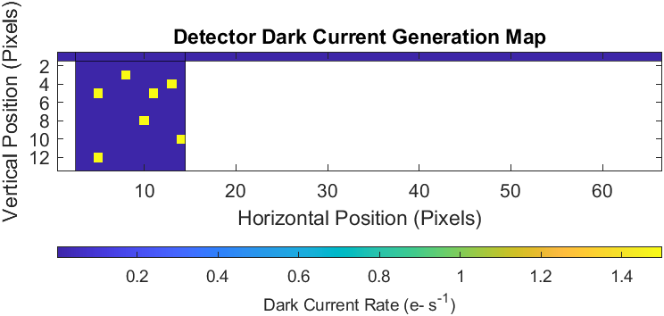
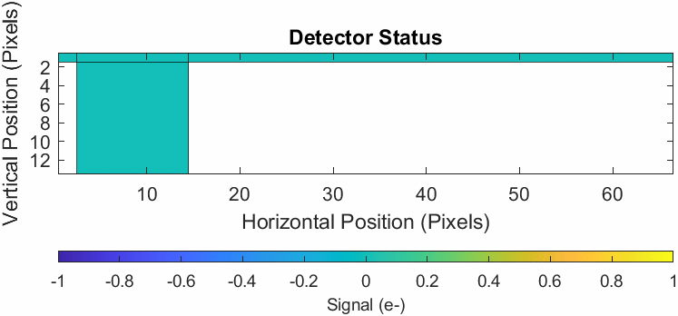
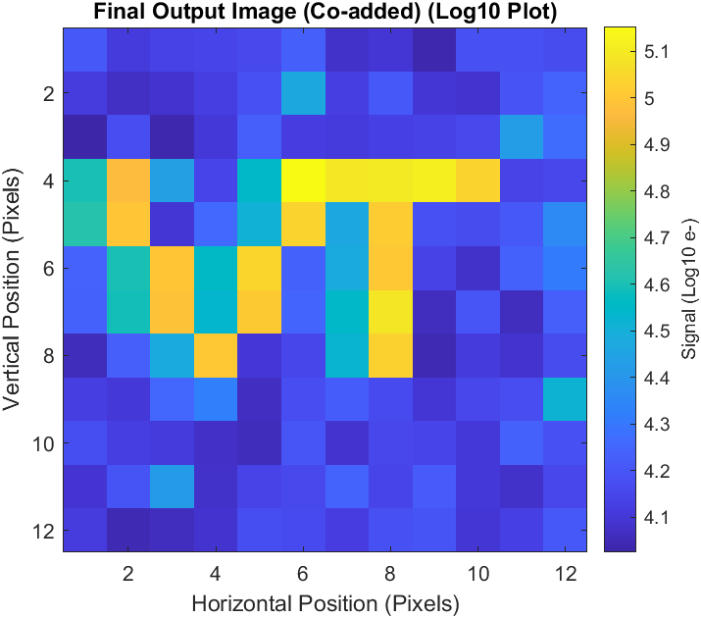
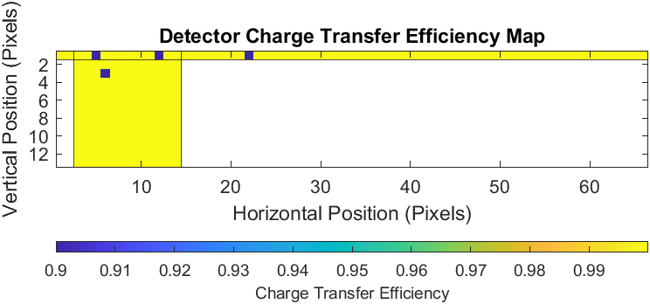
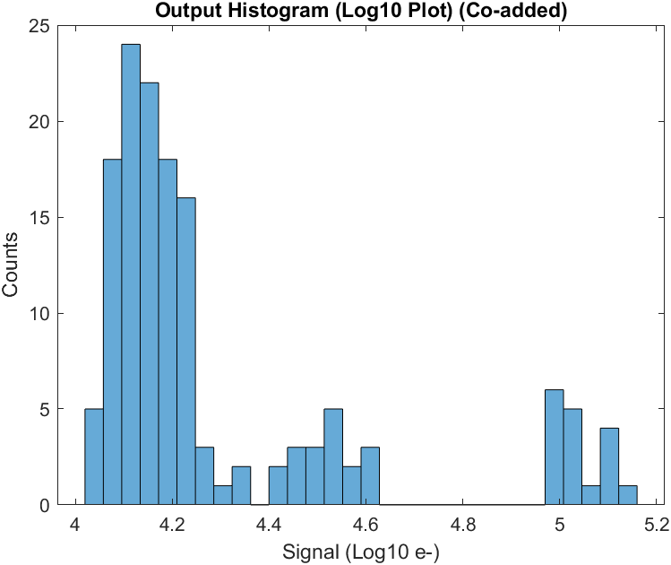
Demonstration
2nd example showing the movement of charge within the detector

Slide 15
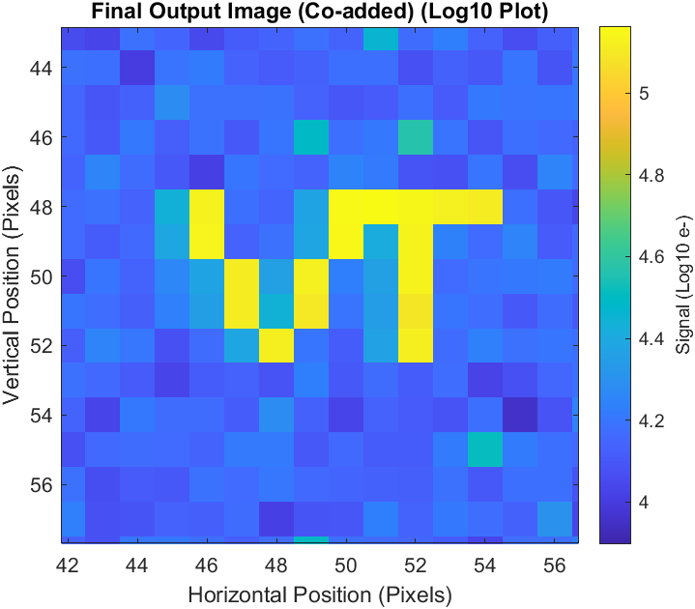
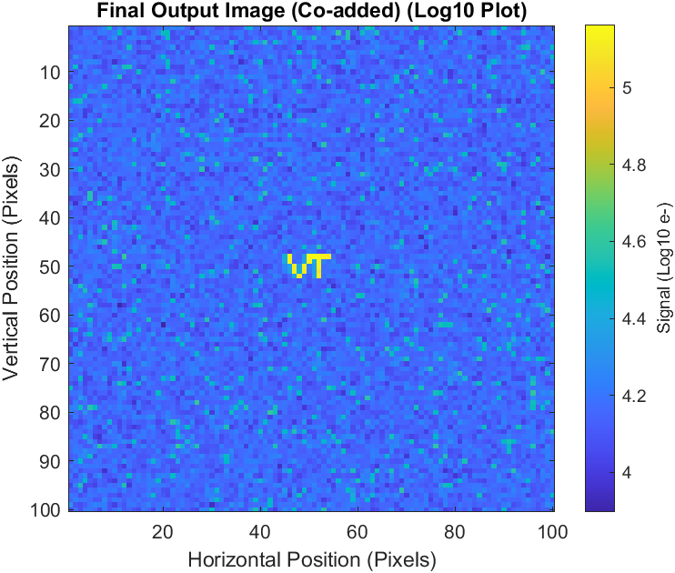
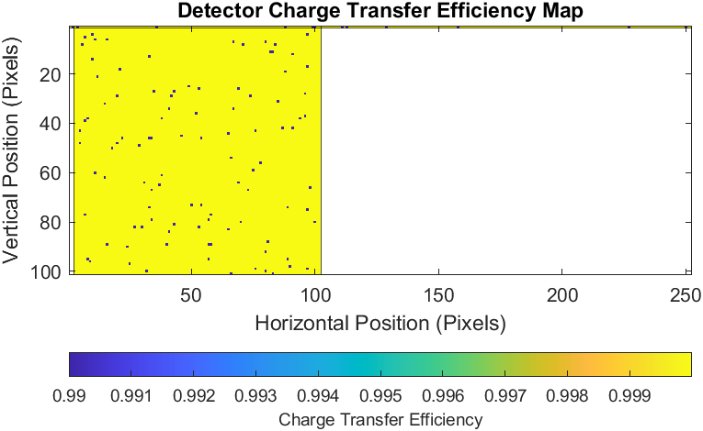
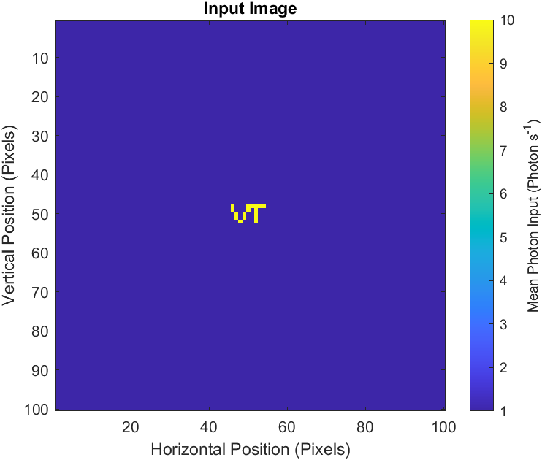
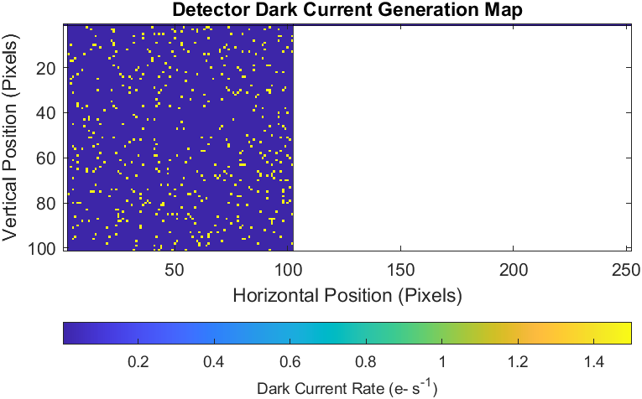
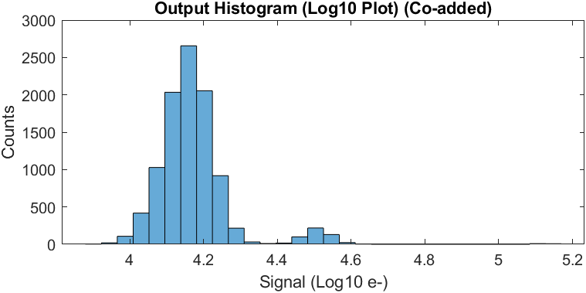
Demonstration
3rd Example using a 100 x 100 pixel detector
SIMULATION
Amplified Dark Current
Input Signal

Slide 16
Assumptions & Limitations
Currently limited to monoenergetic, constant photon inputs
No method to discriminate between photons of different wavelengths that may have differing quantum efficiency (interacting quantum efficiency / quantum yield)
Limited to photon energies unlikely to produce more than 2 e⁻ per interacting photons
Limited by the quantum yield model currently incorporated
CCD response is linear across pixel charge level
Pixel properties are not dependent on charge level
Pixel size does not impact pixel properties
Pixel properties (such as dark current, charge diffusion, light gathering area, etc) are not explicitly tied to the provided size of the pixel

Slide 17
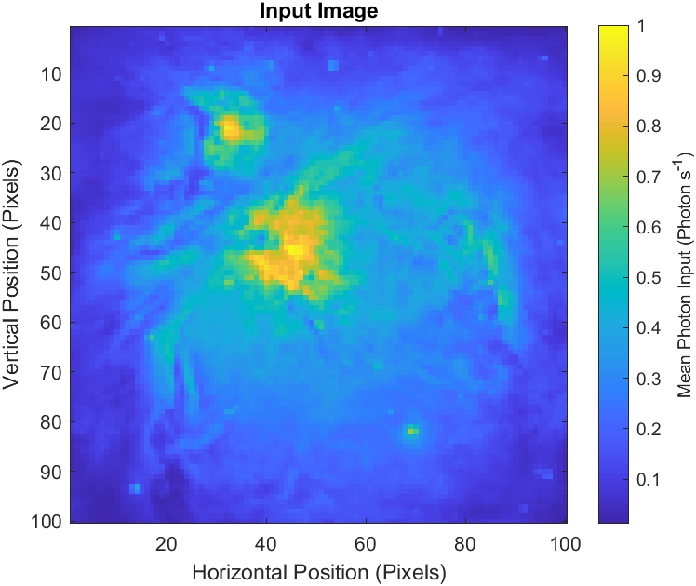
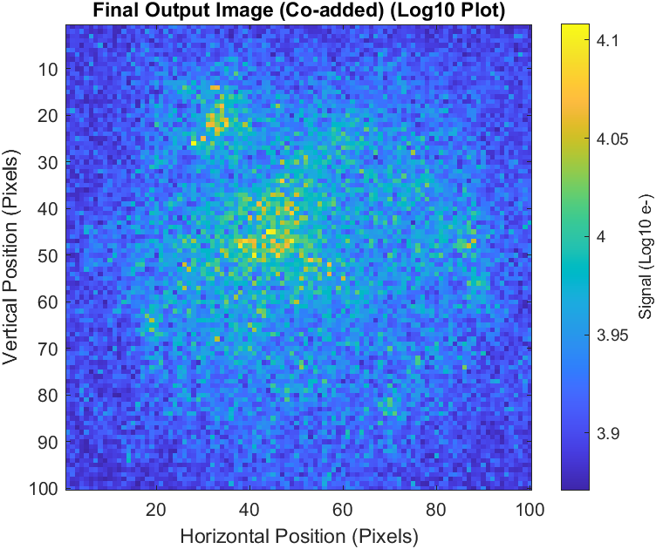
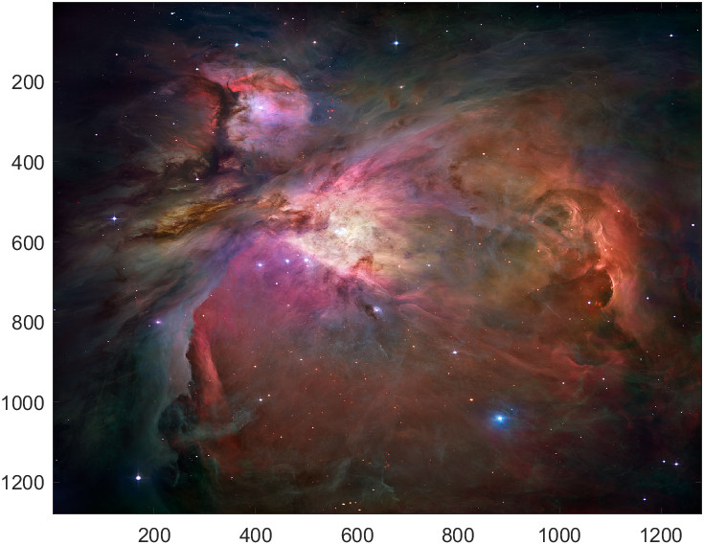
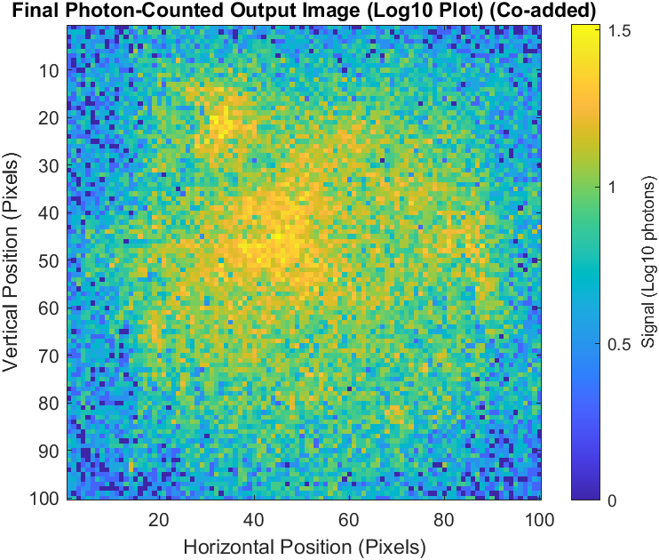
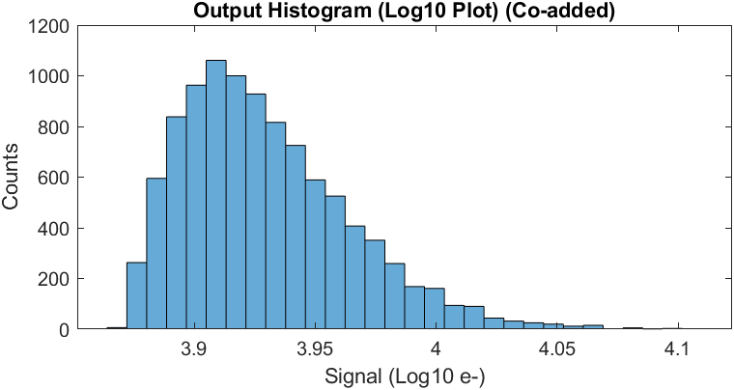
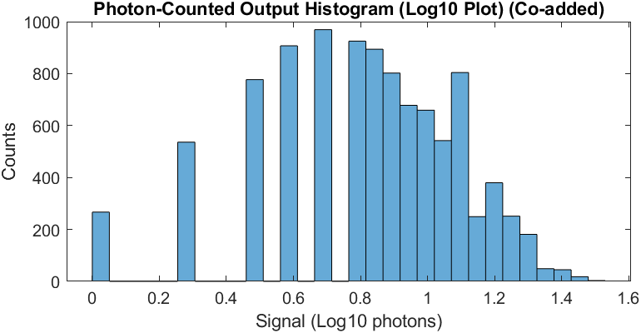
Example Applications
Hubble Image of Orion Nebula processed through a 100 x 100 detector simulation
Resized to 100 x 100 resolution and converted to gray-scale
0.2 s integration time, 150 read-outs => ~17 hr run time
Original Image

Slide 18
Summary & Future Work
A model has been developed in MATLAB to simulate each step of the CCD readout process
Allows for treatment of pixel level noise and charge transfer properties
Enables virtual simulation of realistic read-out sequences
Image read-out
Detector characterization
Performance degradation studies
Etc.
Future work will focus on increasing model fidelity, quality-of-life improvements, optimizing performance
Treatment of pixel blooming / charge diffusion
Trap / radiation (cosmic ray) modelling
Modelling of read-out process to conversion of signal into DN
Treatment of high energy photons
Increased figure output and save data options
Ability to incorporate time-dynamic input and pixel properties

Slide 19
References
[1] Scott, A., Beaton, A., Roy, N., Côté, P., and Hutchings, J. “NUV Performance of E2v Large BICMOS Array for CASTOR.” High Energy, Optical, and Infrared Detectors for Astronomy VII, Vol. 9915, No. July 2016, 2016, p. 99151T. https://doi.org/10.1117/12.2231750.
[2] Basden, A. G., Haniff, C. A., and Mackay, C. D. “Photon Counting Strategies with Low-Light-Level CCDs.” Vol. 991, 2003, pp. 985–991.

